Slide 1
Edu-books app
SEMESTER PROJECT
TOFFAH ATO KWAMENA A.
10812592

Slide 2
PROBLEM STATEMENT
The students of University of Ghana require many different books and study materials for their courses.
Unfortunately, they often have trouble obtaining these learning resources.
The Edu-Books App (Both web and android) will be designed to provide students of the University of Ghana a convenient way to acquire free e-books and course resources.

Slide 3
USER REQUIREMENTS
1. The user must sign in to access resources.
2. The user must be able to download e-books and course resources.
3. The user must be able to request for unavailable resources.

Slide 4
Functional requirements
1. The system must allow users to register or create an account.
2. The system must allow only signed in users to access e-book resources.
3. The system must group e-books by category (subject).
4. The system must allow users to download e-books for various courses.
5. The system must indicate download status.
6. The system must allow a user to cancel an ongoing download.
7. The system must allow users to request for unavailable books or course resources.

Slide 5
Non-Functional requirements
1. The system must host e-books and resources on a remote and reliable server.
2. The system must store all downloads in a single location.
3. The system must contain a database storing all registered users.
4. The system must contain a database storing all available books and their information.

Slide 6
Languages
1. Web App
• Front End: HTML, CSS, JavaScript
• Back End: SQL, PHP
2. Android App
• Kotlin
• SQLite

Slide 7
Software process
As the requirements of the system are known beforehand and changes will be minimal the system will be developed using a plan driven process, specifically the Waterfall Model.

Slide 8
USE CASE MODEL

Slide 9
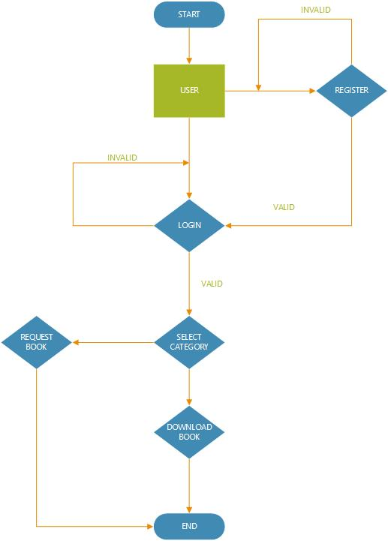
FLOW DIAGRAM

Slide 10
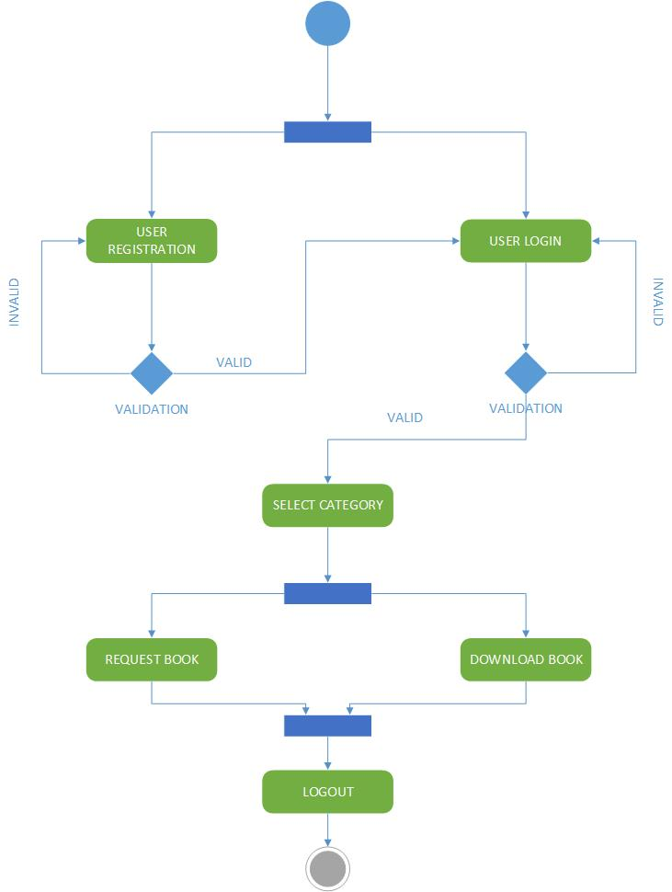
ACTIVITY DIAGRAM

Slide 11
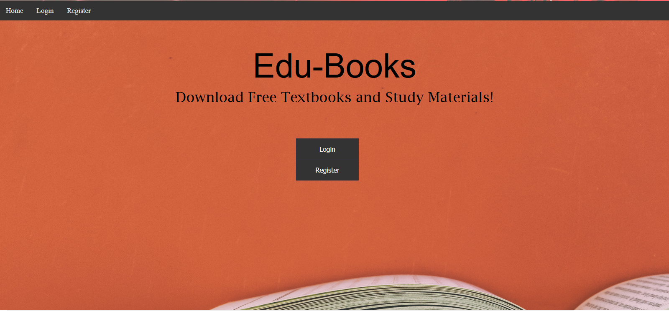
Web app homepage

Slide 12
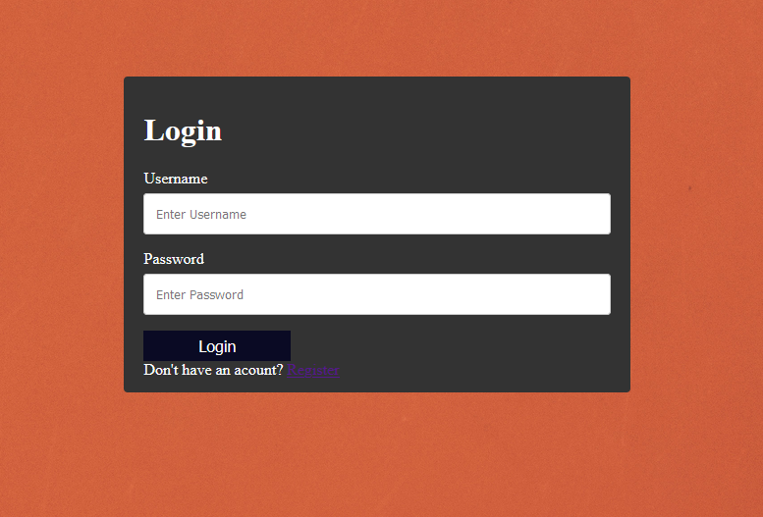
Web app login

Slide 13
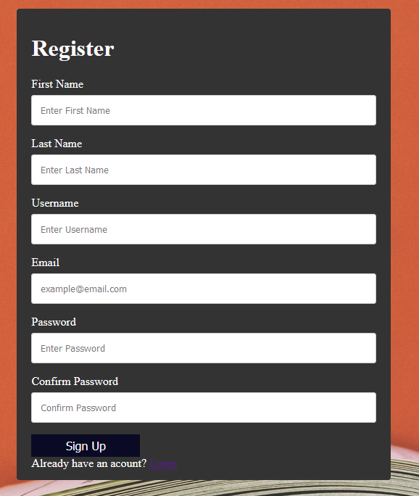
Web app registration

Slide 14
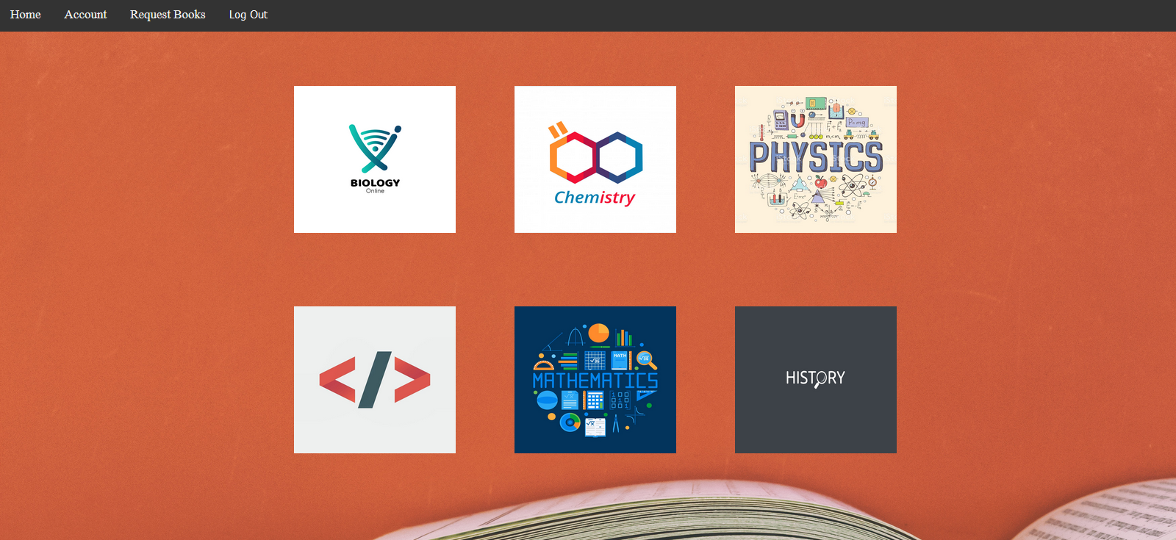
Web app main page

Slide 15
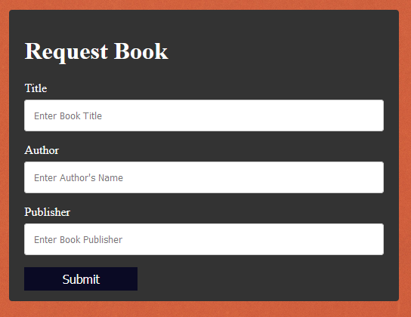
Web app request page

